Slide 1
GAN for small network

Slide 2
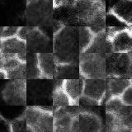
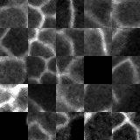
Small network GAN
Generated images
Real images

Slide 3
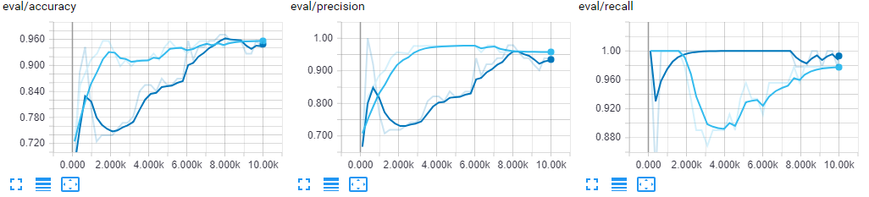
Tiny classifier with and without transferring parameters from GAN

Slide 4
All rosettes that are manually selected from the small network predictions
Rosettes: 381
High probability: 83
Normal probability: 298
Created a new dataset (128x128)
2/3 of the rosettes go to the training dataset
1/3 of the rosettes go to the validation dataset
Rosette : non-rosette is 1:1

Slide 5
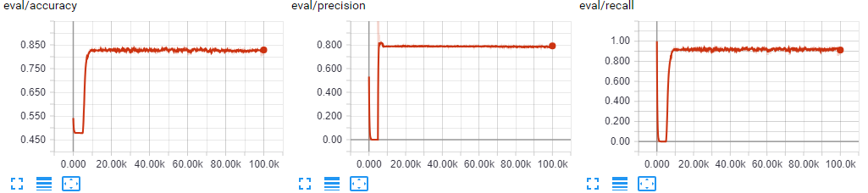
Use the new dataset to train a regular size network (128x128 input)

Slide 6
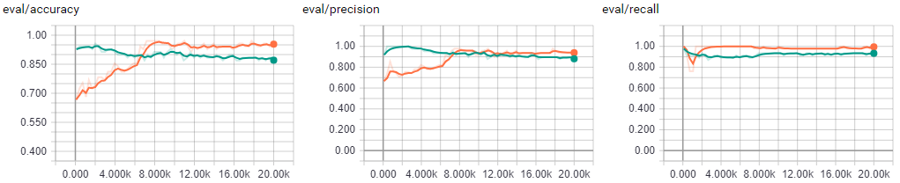
Use a dataset with fewer samples – 32x32 network
Using only 1/3 of samples in the training dataset.
Green is the network without transfer learning, Orange is the network with transfer learning.

Slide 7
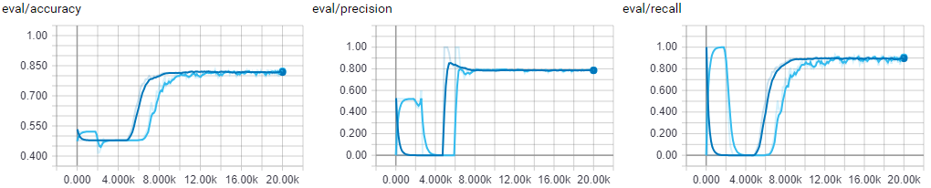
Use a dataset with fewer samples – 128x128 network
Using only 1/3 of samples in the training dataset.
Dark blue is the network without transfer learning, light blue is the network with transfer learning.

